Slide 1
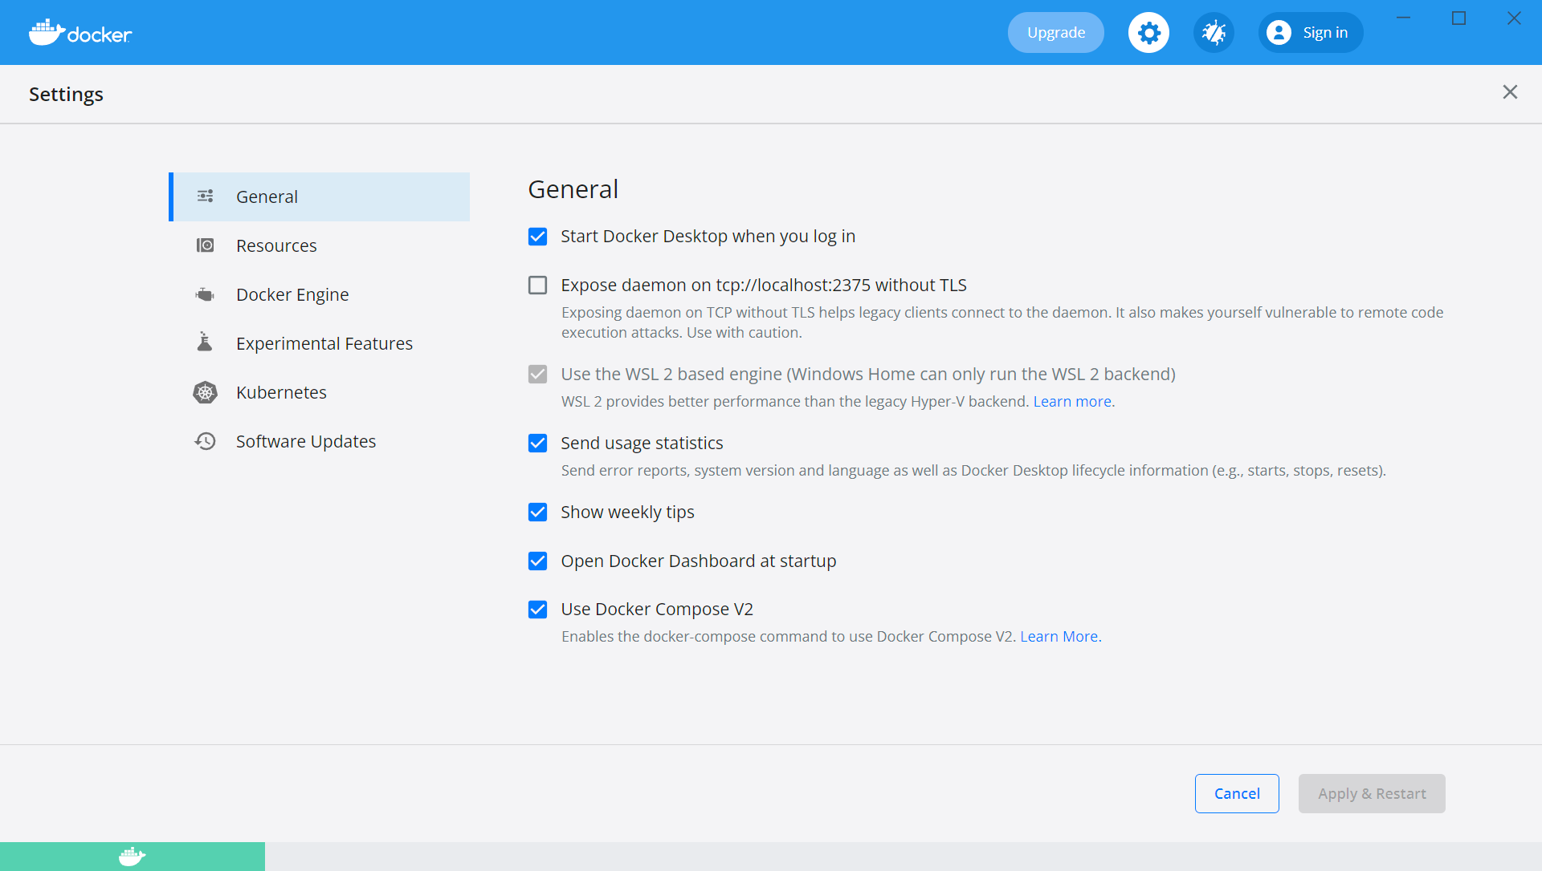
Docker 환경 준비 #1
Docker

Slide 2
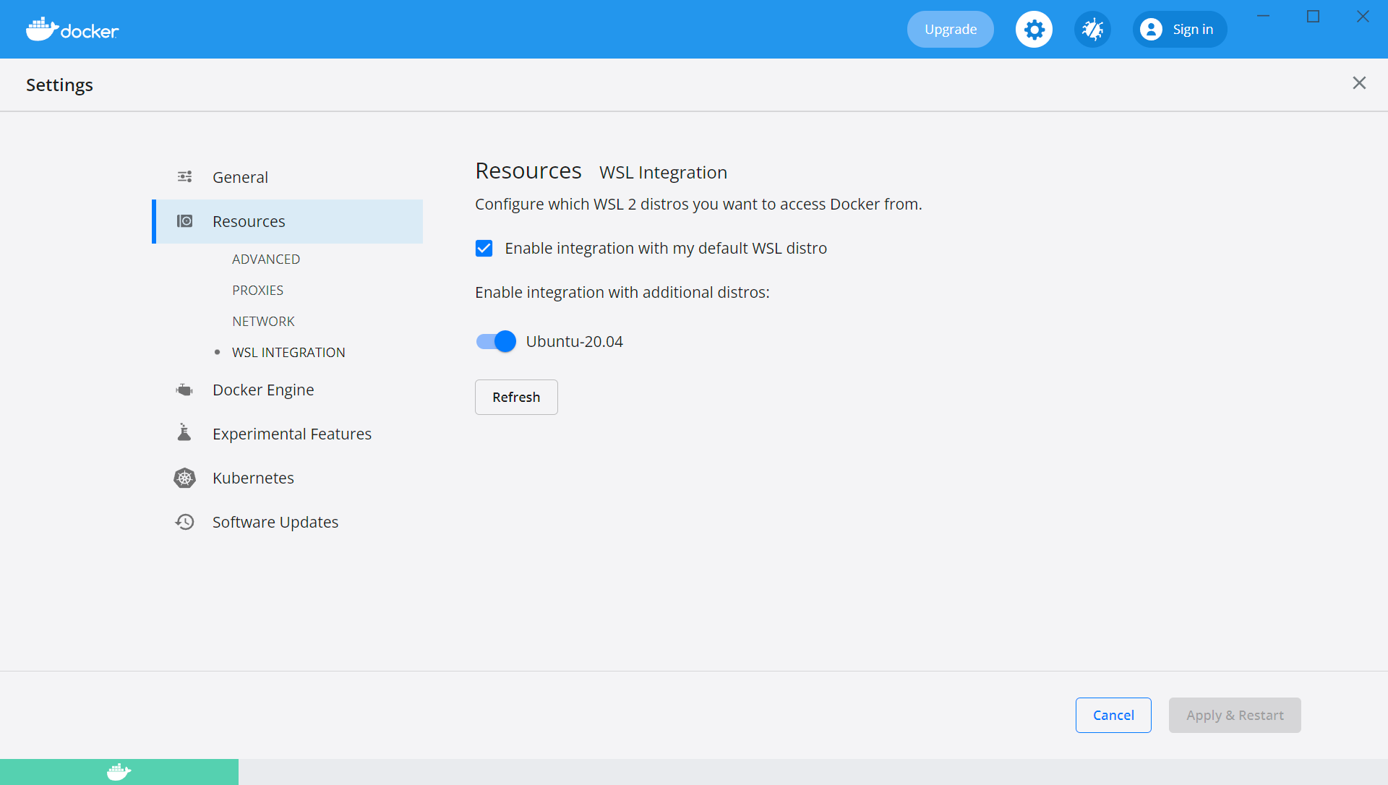
Docker 환경 준비 #2
Docker

Slide 3
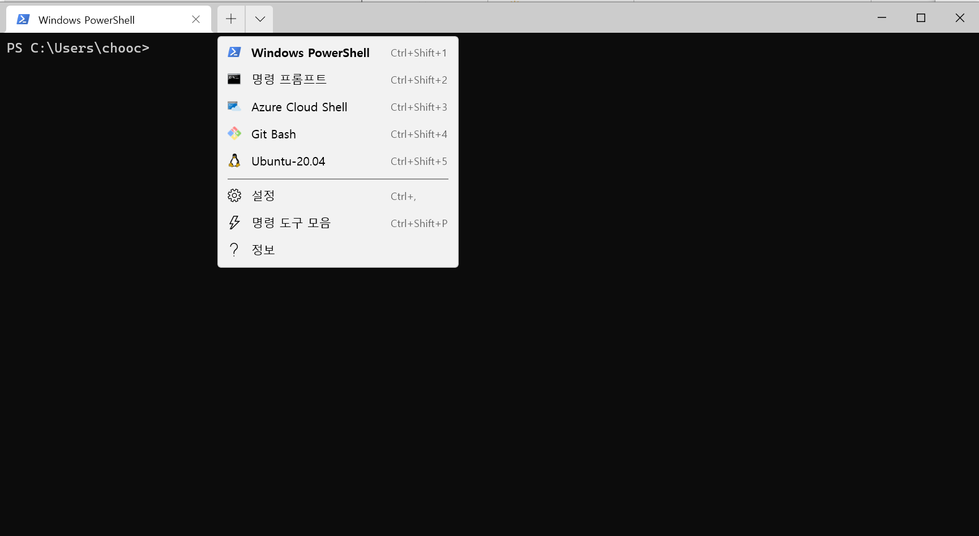
Docker 환경 확인 #1
Docker

Slide 4
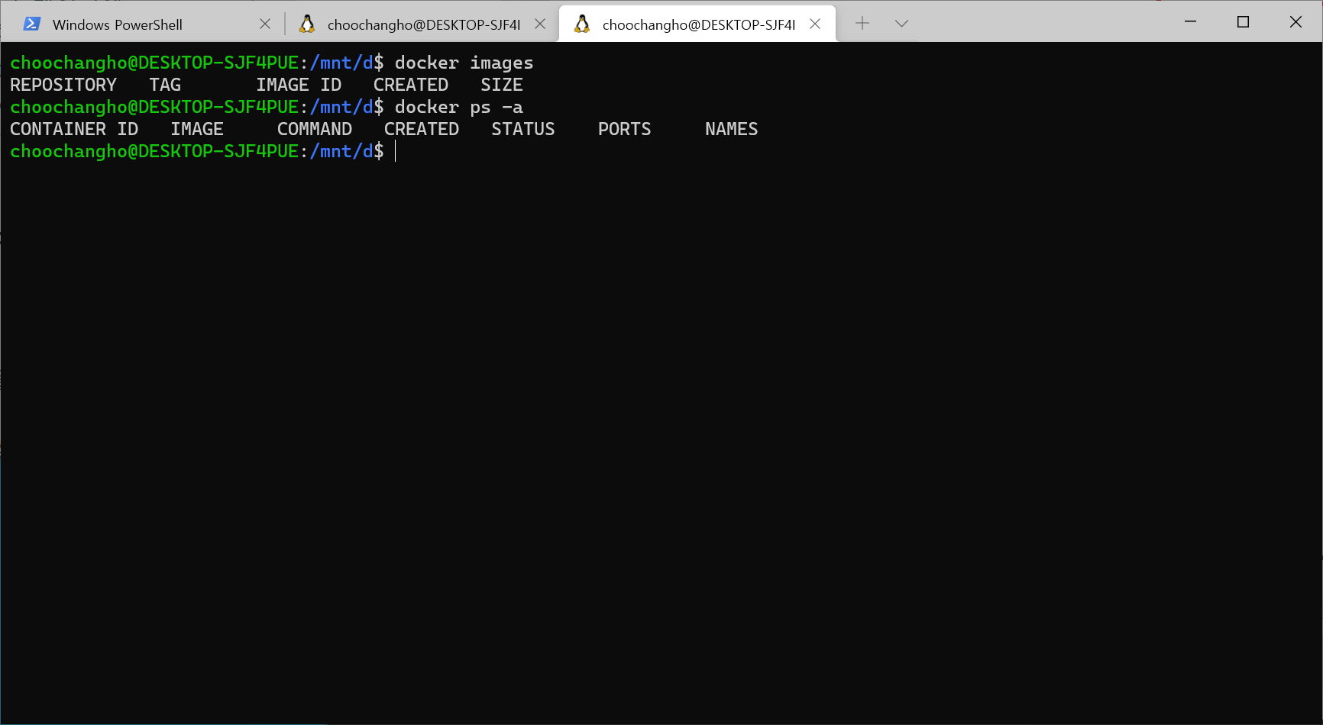
Docker 환경 확인 #2
Docker

Slide 5
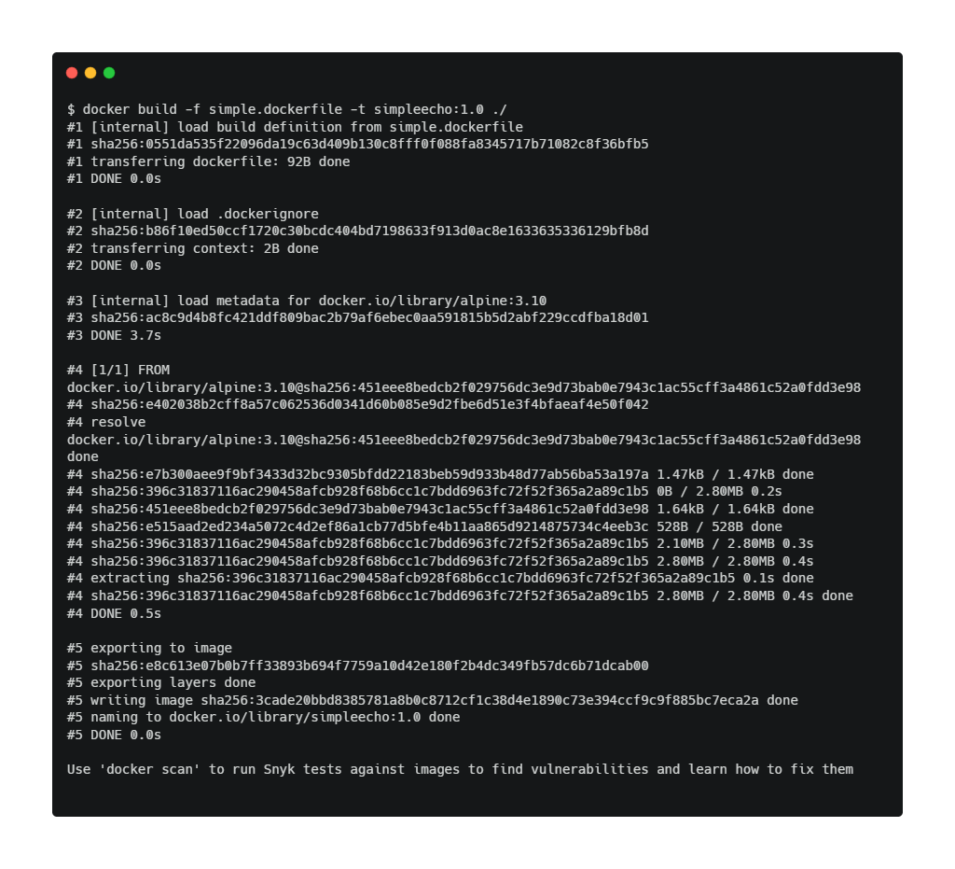
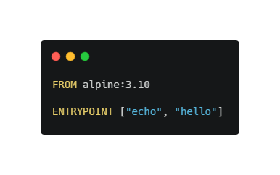
Docker 빌드 overview
Docker
2
1
<lab/day1/lab2/simple.dockerfile>
-f : <dockerfile name>
-t : <image name[:image tag number]>
./ : dockerfile 의 위치(현재디렉토리)
(*) dockerfile 이름이 Dockerfile이라면 파일 이름 지정 불필요
(Alpine Linux가 필요한 이유) https://namu.wiki/w/Alpine%20Linux/

Slide 6
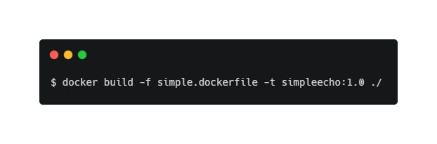
Docker 빌드 명령어
Docker

Slide 7
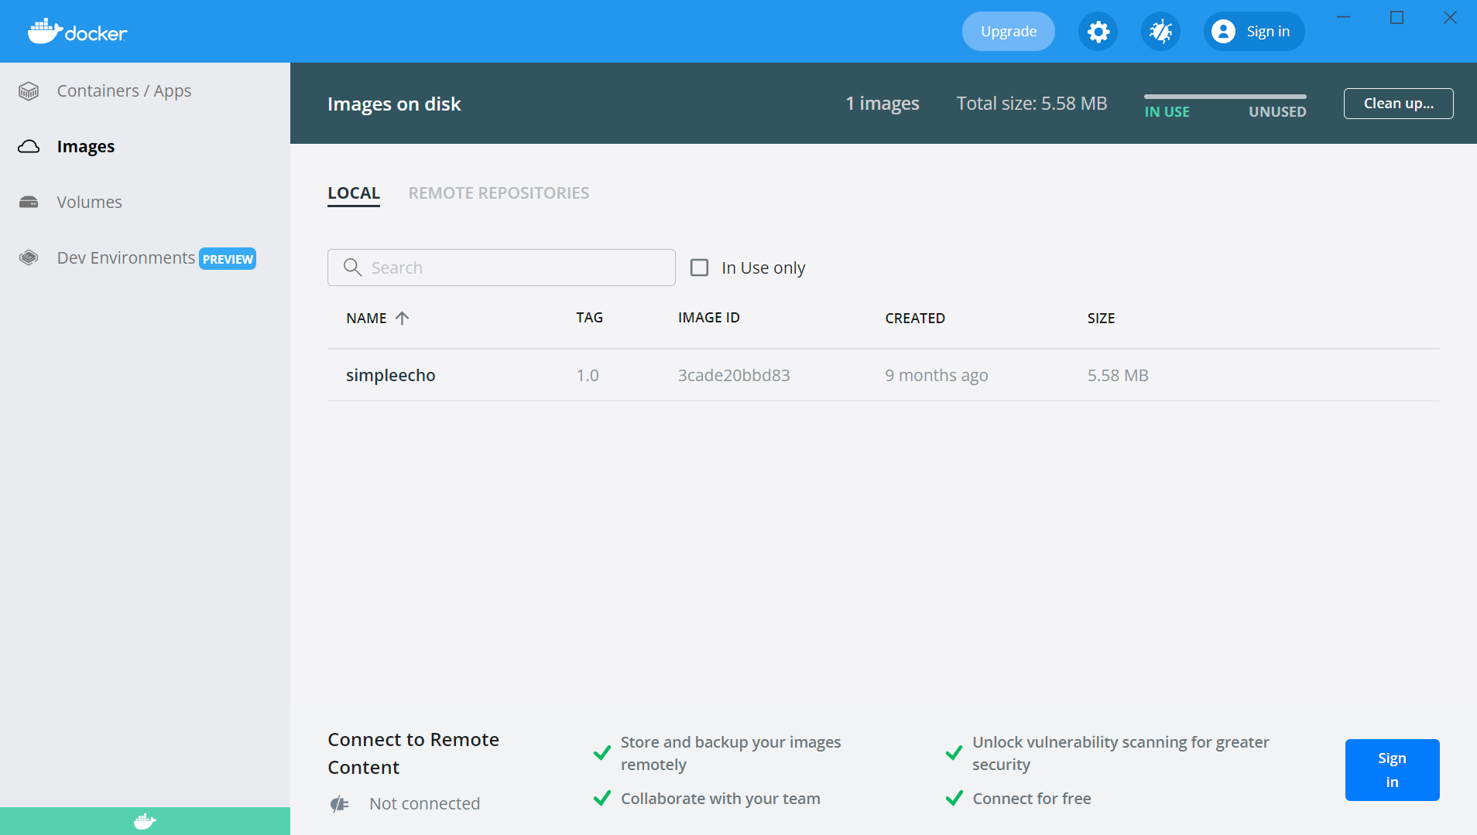
Docker Image 확인
Docker

Slide 8
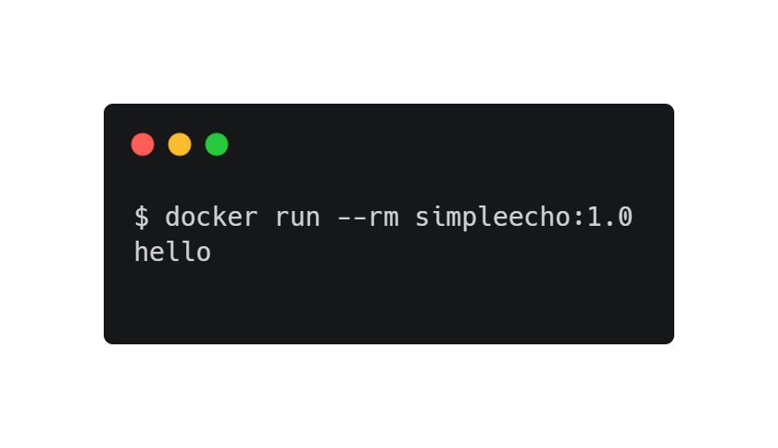
Docker 컨테이너 실행
Docker

Slide 9
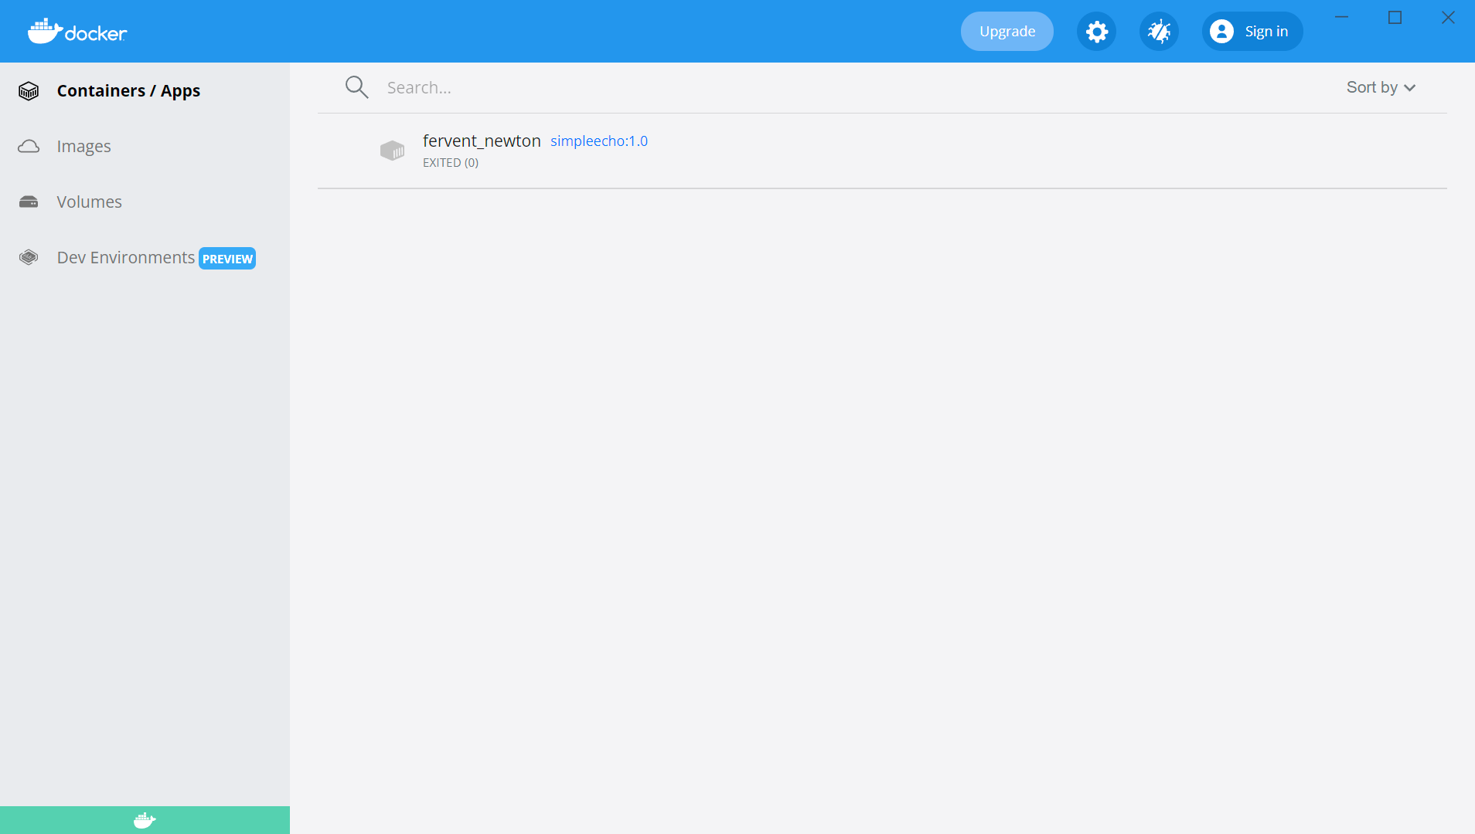
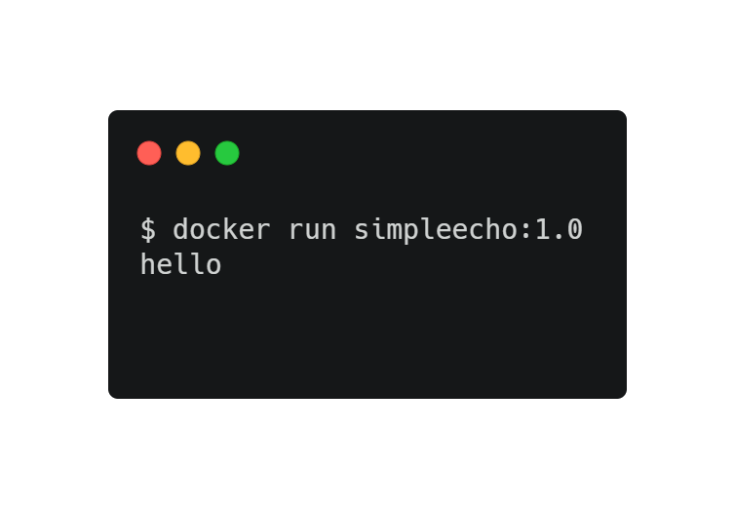
Docker 컨테이너 실행 후 컨테이너 확인
Docker

Slide 10
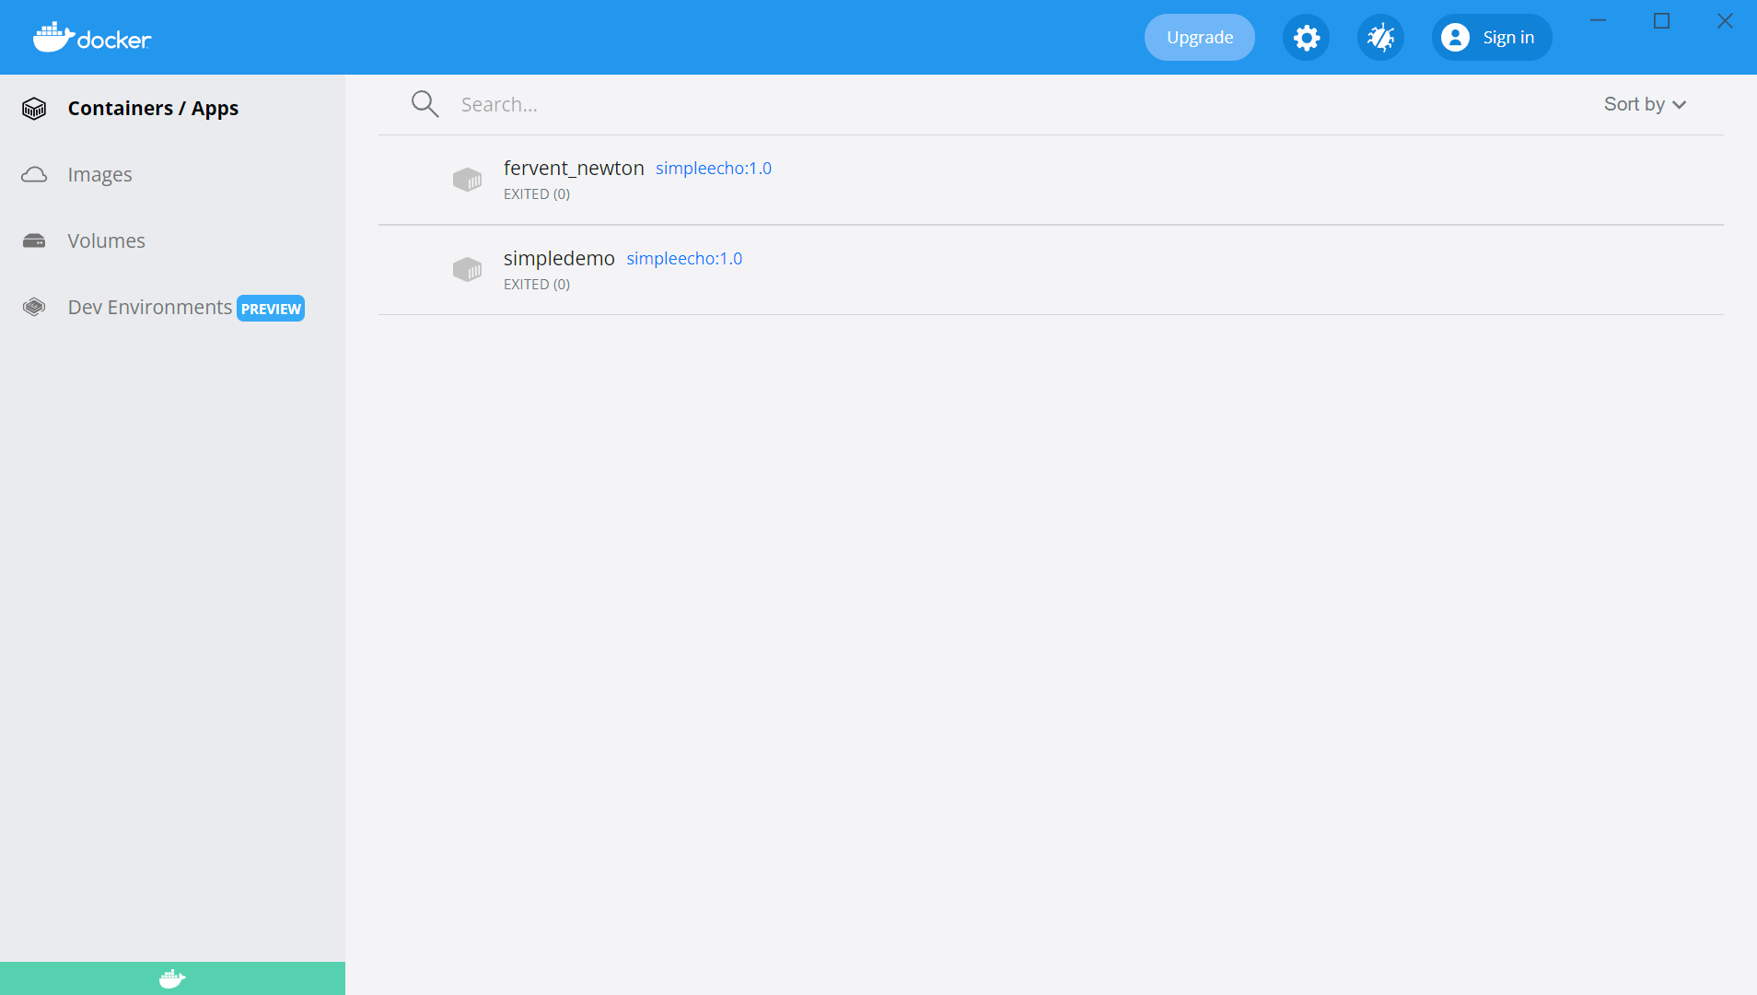
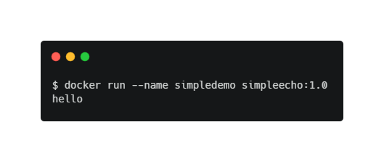
Docker 컨테이너 실행
Docker

Slide 11
컨테이너 run/stop/restart
Docker
$ docker run --name my-nginx -d nginx
Unable to find image 'nginx:latest' locally
latest: Pulling from library/nginx
a2abf6c4d29d: Pull complete
a9edb18cadd1: Pull complete
589b7251471a: Pull complete
186b1aaa4aa6: Pull complete
b4df32aa5a72: Pull complete
a0bcbecc962e: Pull complete
Digest: sha256:0d17b565c37bcbd895e9d92315a05c1c3c9a29f762b011a10c54a66cd53c9b31
Status: Downloaded newer image for nginx:latest
28617e6e7e4ca2dc5f264c55f7e6855bfdaa12b1047943e921c4b4a7f5570dfb
$ docker stop my-nginx
my-nginx
$ docker start my-nginx
my-nginx
$ docker ps
CONTAINER ID IMAGE COMMAND CREATED STATUS PORTS NAMES
2ac80ecd3b3a nginx "/docker-entrypoint.…" 5 seconds ago Up 7 seconds 80/tcp my-nginx
Docker Desktop 확인

Slide 12
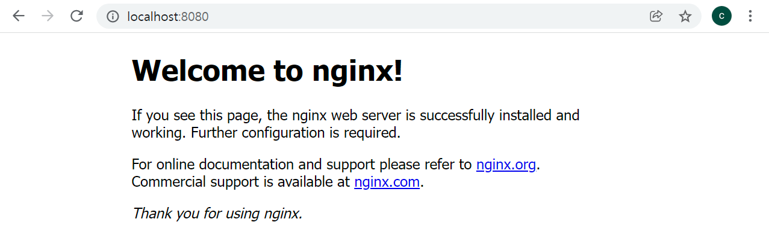
Port Expose
Docker
$ docker rm my-nginx
my-nginx
$ docker run –d –p 8080:80 --name my-nginx nginx
4b023818e8a3198dd0a9ce55d3e4cd412af2fa4bd4a5131d80988de57429e371
[외부포트]:[컨테이너 내부 포트]

Slide 13
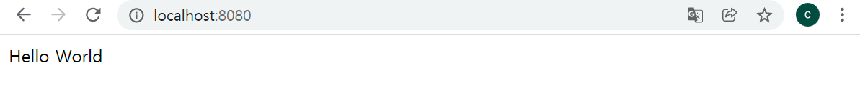
Welcome 메시지 변경
Docker
$ docker exec -ti my-nginx bash
root@9b74722f16bc:/# ls
bin dev docker-entrypoint.sh home lib64 mnt proc run srv tmp var
boot docker-entrypoint.d etc lib media opt root sbin sys usr
root@9b74722f16bc:/# cd /usr/share/nginx/html/
root@9b74722f16bc:/usr/share/nginx/html# ls
50x.html index.html
root@9b74722f16bc:/usr/share/nginx/html# echo "Hello World" > index.html
root@9b74722f16bc:/usr/share/nginx/html# <Ctrl + d>
-t : 가상 tty를 사용 -i : 표준 입출력을 사용

Slide 14
컨테이너 및 이미지 삭제
Docker
$ docker ps -a
CONTAINER ID IMAGE COMMAND CREATED STATUS PORTS NAMES
9b74722f16bc nginx "/docker-entrypoint.…" 26 minutes ago Exited (0) 3 minutes ago my-nginx
bddf0473d352 simpleecho:1.0 "echo hello" 23 hours ago Exited (0) 2 hours ago simpledemo
05b783a8f81c simpleecho:1.0 "echo hello" 23 hours ago Exited (0) 23 hours ago fervent_newton
$ docker stop my-nginx
my-nginx
$ docker rmi nginx
Error response from daemon: conflict: unable to remove repository reference "nginx" (must force) - container 9b74722f16bc is using its referenced image 605c77e624dd
$ docker images
REPOSITORY TAG IMAGE ID CREATED SIZE
nginx latest 605c77e624dd 13 days ago 141MB
$ docker rm 9b74722f16bc
9b74722f16bc
$ docker rmi nginx
Untagged: nginx:latest
Untagged: nginx@sha256:0d17b565c37bcbd895e9d92315a05c1c3c9a29f762b011a10c54a66cd53c9b31
Deleted: sha256:605c77e624ddb75e6110f997c58876baa13f8754486b461117934b24a9dc3a85
Deleted: sha256:b625d8e29573fa369e799ca7c5df8b7a902126d2b7cbeb390af59e4b9e1210c5
Deleted: sha256:7850d382fb05e393e211067c5ca0aada2111fcbe550a90fed04d1c634bd31a14
Deleted: sha256:02b80ac2055edd757a996c3d554e6a8906fd3521e14d1227440afd5163a5f1c4
Deleted: sha256:b92aa5824592ecb46e6d169f8e694a99150ccef01a2aabea7b9c02356cdabe7c
Deleted: sha256:780238f18c540007376dd5e904f583896a69fe620876cabc06977a3af4ba4fb5
Deleted: sha256:2edcec3590a4ec7f40cf0743c15d78fb39d8326bc029073b41ef9727da6c851f

Slide 15
볼륨 마운트
Docker
$ pwd
bash: /d/docker-k8s-hands-on: Is a directory
$ docker run --name my-nginx -p 8080:80 -v $(pwd)/doc_root/:/usr/share/nginx/html:rw -d nginx
Unable to find image 'nginx:latest' locally
latest: Pulling from library/nginx
a2abf6c4d29d: Pull complete
a9edb18cadd1: Pull complete
589b7251471a: Pull complete
186b1aaa4aa6: Pull complete
b4df32aa5a72: Pull complete
a0bcbecc962e: Pull complete
Digest: sha256:0d17b565c37bcbd895e9d92315a05c1c3c9a29f762b011a10c54a66cd53c9b31
Status: Downloaded newer image for nginx:latest
Facaa9fca4b22152b65ebbe0e810f29ee8e232c1e246b5f89c17373058c62c9c
# docker-k8s-hands-on/lab/day1/lab2/index.html 파일을 doc_root 로 파일 복사
# 브라우저에서 확인(localhost:8080)
(Command-line reference) https://docs.docker.com/reference/

Slide 16
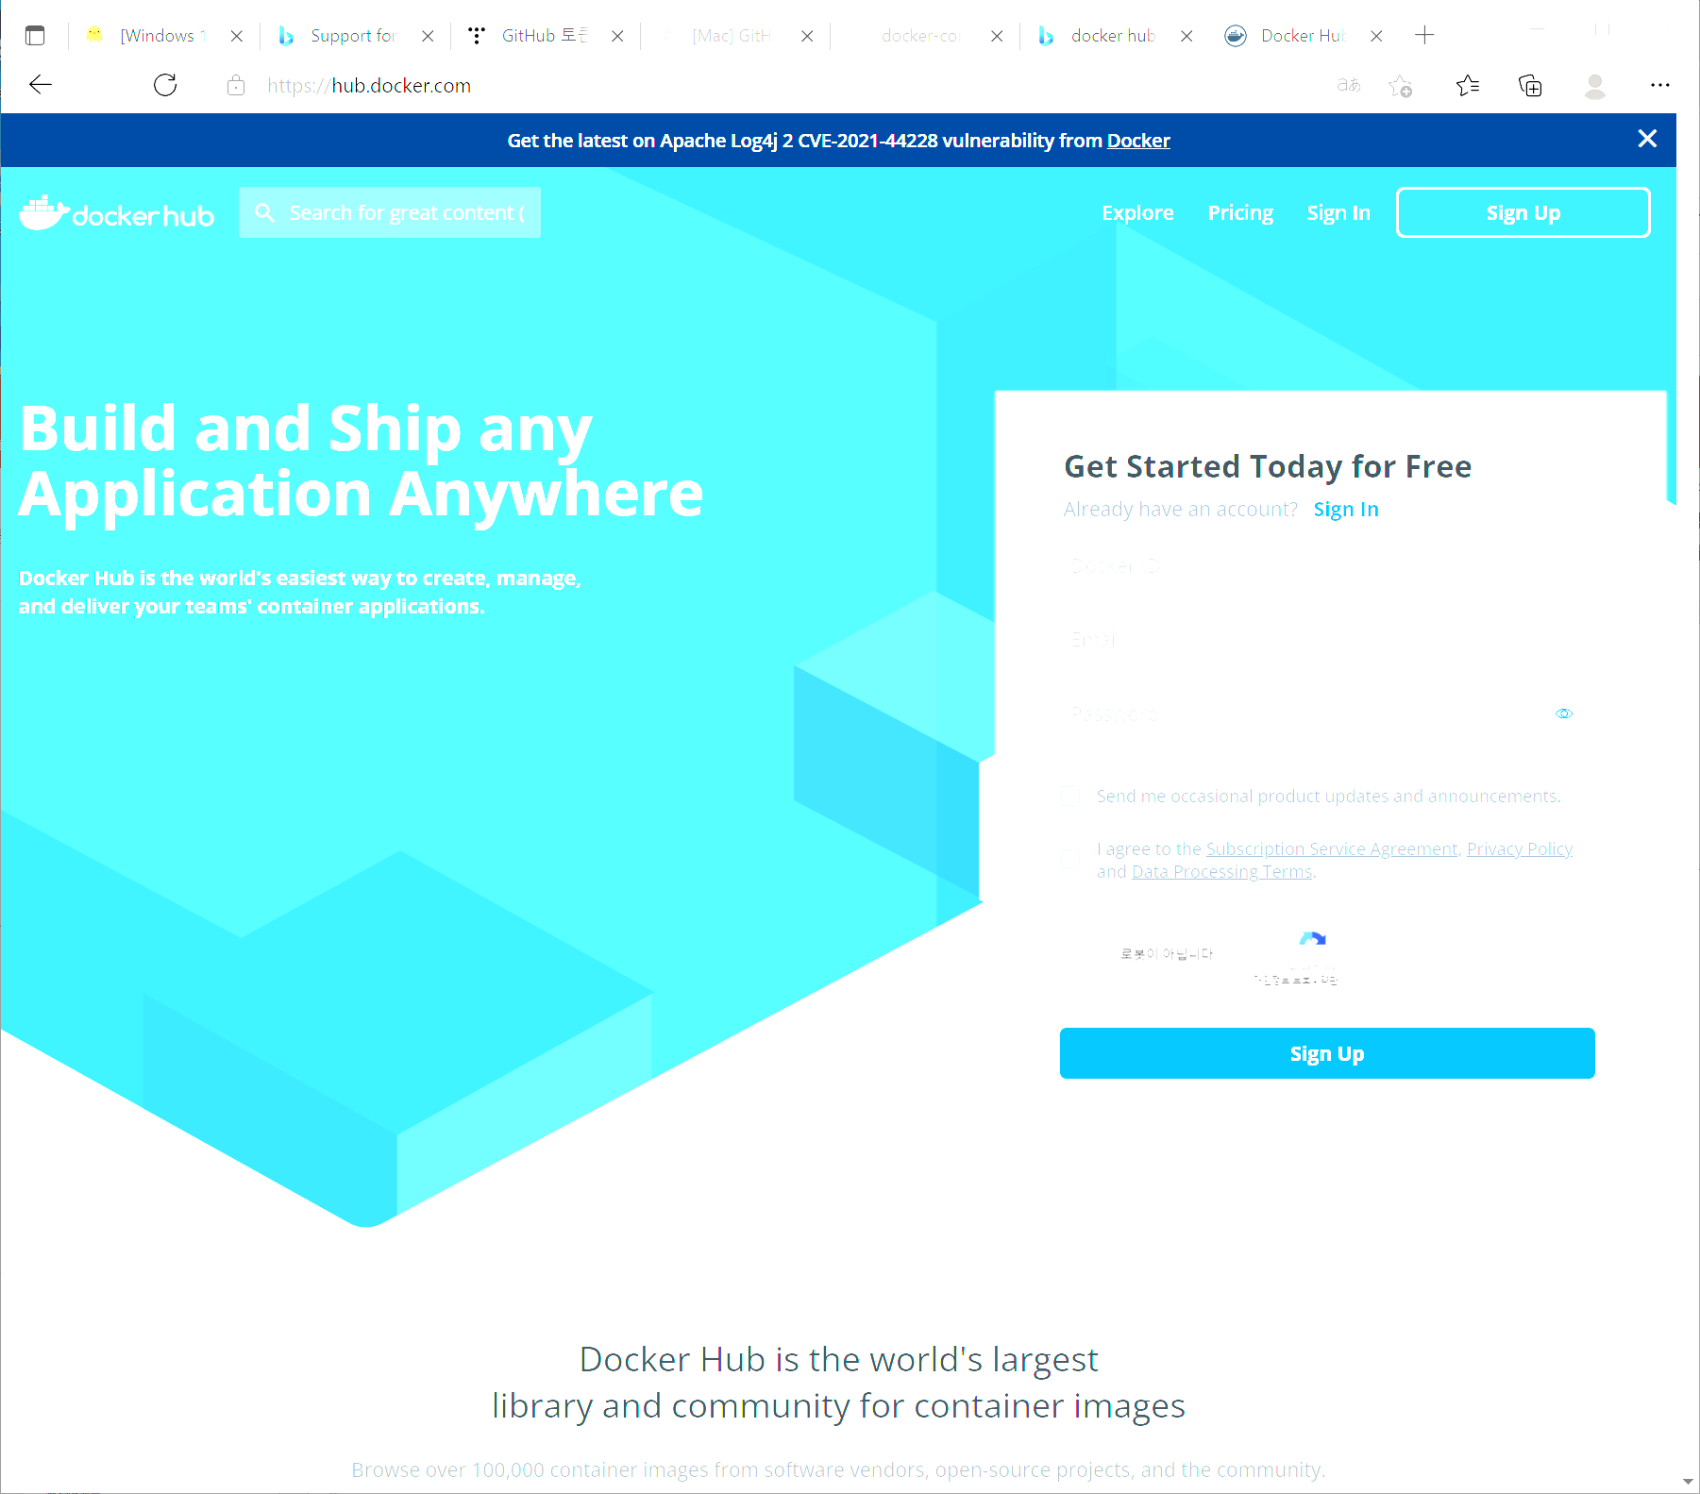
Docker hub 회원 가입
Docker
https://hub.docker.com
Docker ID : repository 이름에 사용됨
Email : <자신의 이메일 주소>
Password : <사용할 패스워드>

Slide 17
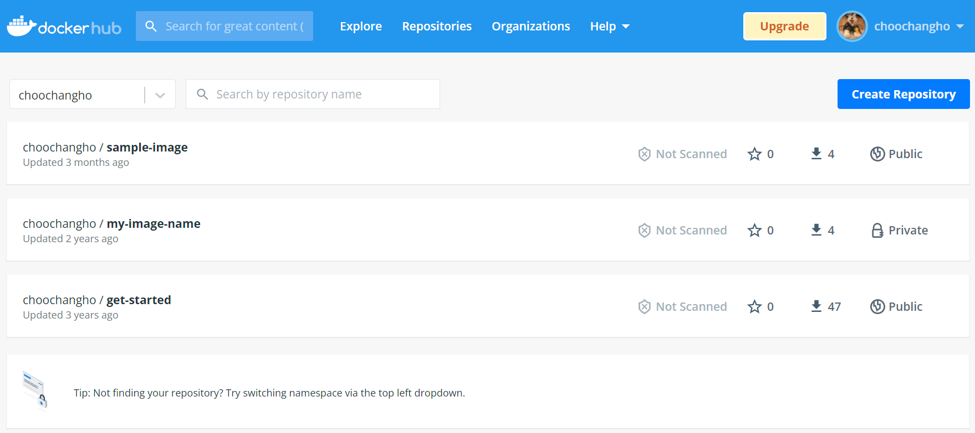
Repository 목록
Docker

Slide 18
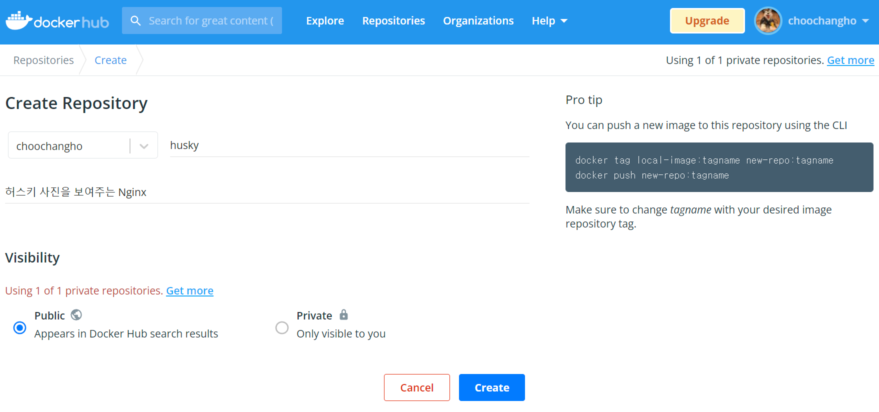
Repository 생성
Docker

Slide 19
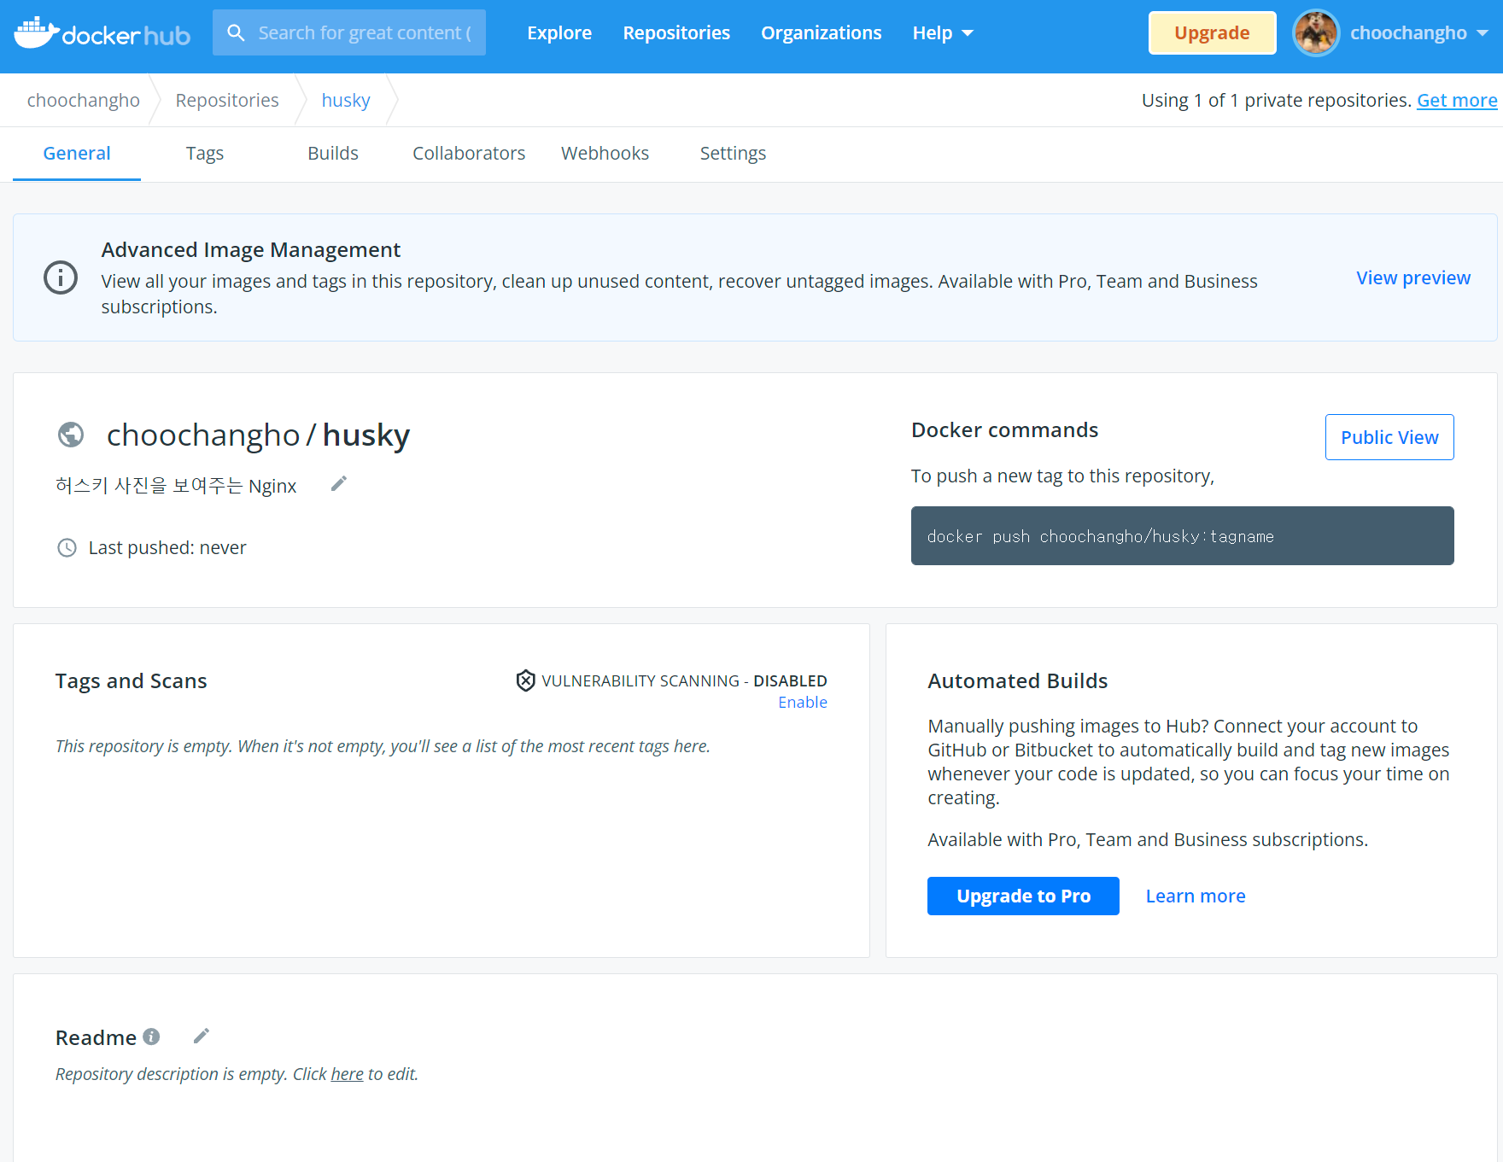
Repository 생성 완료
Docker

Slide 20
이미지 빌드
Docker
# 실행중인 컨테이너 모두 중지
$ docker stop $(docker ps –a –q)
# 모든 컨테이너 삭제
$ docker rm $(docker ps -a -q)
# 모든 이미지 (강제) 삭제
$ docker rmi -f $(docker images -q)
# 이미지 빌드
$ cd docker-k8s-hands-on/lab/day1/lab2
$ docker build -t choochangho/husky -f nginx-husky-dockerfile .
# 이미지 확인
$ docker images
REPOSITORY TAG IMAGE ID CREATED SIZE
choochangho/husky latest ce065571490c 4 hours ago 141MB
nginx latest 605c77e624dd 13 days ago 141MB

Slide 21

이미지 푸쉬
Docker
# docker hub 로그인
$ docker login
# 모든 이미지 푸쉬
$ docker push choochangho/husky:latest
The push refers to repository [docker.io/choochangho/husky]
fe2cd13067b1: Pushed
d874fd2bc83b: Mounted from library/nginx
32ce5f6a5106: Mounted from library/nginx
f1db227348d0: Mounted from library/nginx
b8d6e692a25e: Mounted from library/nginx
e379e8aedd4d: Mounted from library/nginx
2edcec3590a4: Mounted from library/nginx
1.0: digest: sha256:32c2eb2fe7243034473d5d66a7e2e446d909f0dbada64d745ccd05e9b5cb389a size: 1777
docker login 또는 push 과정에 에러가 발생할 수 있다. 이때는 ~/.docker/config.json 파일을 삭제 후 다시 시도해 본다.

Slide 22

Repository 확인
Docker

Slide 23
테스트
Docker
# docker hub 에서 이미지를 내려 받는지 확인하기 위해 모든 컨테이너와 이미지를 삭제한다.
$ docker stop $(docker ps –a –q)
# 모든 컨테이너 삭제
$ docker rm $(docker ps -a -q)
# 모든 이미지 (강제) 삭제
$ docker rmi -f $(docker images -q)
# 이미지 확인
$ docker images
REPOSITORY TAG IMAGE ID CREATED SIZE
# 컨테이너 실행(브라우저에서 확인)
$ docker run -p 8080:80 -d --name my-husky choochangho/husky
Unable to find image 'choochangho/husky:latest' locally
latest: Pulling from choochangho/husky
…(중략)…

Slide 24
Dockerfile 분리
Docker
다양한 환경에서 Dockerfile이 사용될 수 있다.
이러한 상황을 염두에 두고 아래와 같은 형태로 파일을 분리하는 것을 추천한다.
환경 | 파일명 | 설명
Local | dockerfile-local | 개발자 PC
Test | dockerfile-test | 빌드 테스트
Stage | dockerfile-stage | release 직전 테스트
Production | dockerfile-production | 운영

Slide 25
Multi Stage Build Concept
Docker
One of the most challenging things about building images is keeping the image size down. Each instruction in the Dockerfile adds a layer to the image, and you need to remember to clean up any artifacts you don’t need before moving on to the next layer.
To write a really efficient Dockerfile, you have traditionally needed to employ shell tricks and other logic to keep the layers as small as possible and to ensure that each layer has the artifacts it needs from the previous layer and nothing else.
It was actually very common to have one Dockerfile to use for development (which contained everything needed to build your application), and a slimmed-down one to use for production, which only contained your application and exactly what was needed to run it. This has been referred to as the “builder pattern”. Maintaining two Dockerfiles is not ideal.
https://docs.docker.com/develop/develop-images/multistage-build/#before-multi-stage-builds

Slide 26
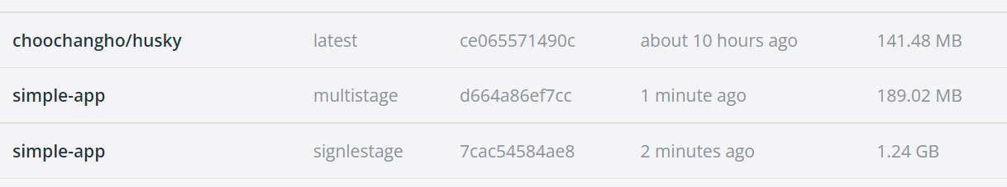
Build 용량 비교
Docker
$ cd docker-k8s-hands-on/lab/day/lab1/multistage $ docker image build –t simple-app:singlestage .
$ docker image build –t simple-app:multistage –f multistage-dockerfile .

